Slide 1
Base Running
The basics

Slide 2
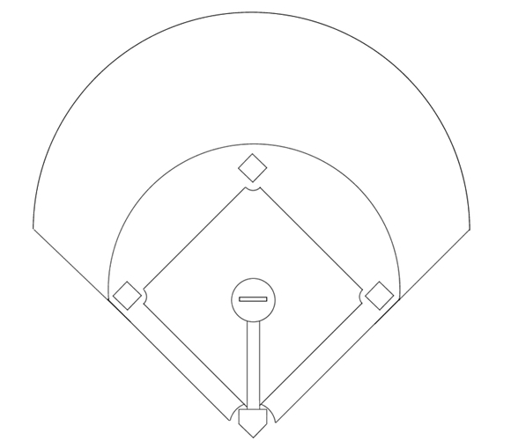
Batters can advance on
Base hit
Base-on-Balls (free walk)
Hit-by-Pitch
Dropped third strike

Slide 3
Batters can advance on
Base hit
Base-on-Balls (free walk)
Hit-by-Pitch
Dropped third strike
Not allowed in slowpitch

Slide 4
All Batters run in the same direction !

Slide 5
Batters are allowed to
deviate (±1 m)
stop
to avoid a tag
1

Slide 6
Batters are not allowed to
run back to avoid a tag
refuse a hit
If you hit the ball (fair), you run

Slide 7
6
Base Runners are allowed to
deviate (±1m)

Slide 8
6
Base Runners are allowed to
deviate (±1m)
stop

Slide 9
6
Base Runners are allowed to
deviate (±1m)
stop
return to a previous base

Slide 10
Base Runners are not allowed to pass a runner

Slide 11
Base Runners are not allowed to occupy the same base !

Slide 12
Base Running
(not-)forced

Slide 13
Two rules to understand forced vs not-forced
If you hit the ball (fair), you run
Base Runners are not allowed to occupy the same base !

Slide 14
If you hit the ball (fair), you run
Base Runners are not allowed to occupy the same base !

Slide 15
If you hit the ball (fair), you run
Base Runners are not allowed to occupy the same base !

Slide 16
If you hit the ball (fair), you run
Base Runners are not allowed to occupy the same base !

Slide 17
If you hit the ball (fair), you run
Base Runners are not allowed to occupy the same base !

Slide 18
If you hit the ball (fair), you run
Base Runners are not allowed to occupy the same base !
1
New Batter Runner on first
2

Slide 19
If you hit the ball (fair), you run
Base Runners are not allowed to occupy the same base !
1
2

Slide 20
If you hit the ball (fair), you run
Base Runners are not allowed to occupy the same base !
1
Runner 1 on first base is forced to run
2

Slide 21
If you hit the ball (fair), you run
Base Runners are not allowed to occupy the same base !
1
Same applies to runners on 2nd and 3rd base
2

Slide 22
If you hit the ball (fair), you run
Base Runners are not allowed to occupy the same base !
1
Same applies to runners on 2nd and 3rd base
2

Slide 23
If you hit the ball (fair), you run
Base Runners are not allowed to occupy the same base !

Slide 24
If you hit the ball (fair), you run
Base Runners are not allowed to occupy the same base !
1
Runner on 2nd base 1e base is open
2

Slide 25
If you hit the ball (fair), you run
Base Runners are not allowed to occupy the same base !
1
2

Slide 26
If you hit the ball (fair), you run
Base Runners are not allowed to occupy the same base !
1
There is no runner advancing to 2nd base. Rule 2 does not apply.
2

Slide 27
If you hit the ball (fair), you run
Base Runners are not allowed to occupy the same base !
1
Runner on 2nd base can choose to run = not-forced
2

Slide 28
If you hit the ball (fair), you run
Base Runners are not allowed to occupy the same base !
1
The batter could try to advance to 2nd base
2

Slide 29
If you hit the ball (fair), you run
Base Runners are not allowed to occupy the same base !
1
2
The batter could try to advance to 2nd base

Slide 30
If you hit the ball (fair), you run
Base Runners are not allowed to occupy the same base !
1
2
The batter could try to advance to 2nd base
The lead runner is not forced,
because the batter was not forced to run to 2nd base.

Slide 31
If you hit the ball (fair), you run
Base Runners are not allowed to occupy the same base !
1
2
Both runners are now at 2nd base. Two options: 1. Runner 1 tries to reach 3rd base
2. Runner 2 tries to get back to 1e base

