Slide 1
Base hit in Center Field No runners

Slide 2
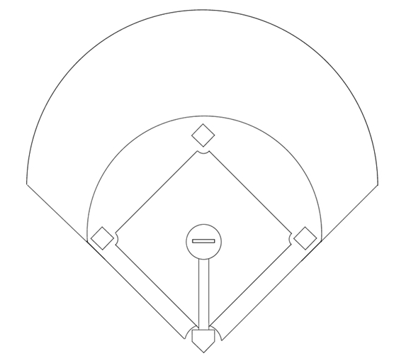
1
Pitcher
2
Catcher
8
3
1e Baser
4
2nd Baser
5
3rd Baser
7
9
6
Short Stop
7
Left Fielder
6
4
8
Center Fielder
9
Right Fielder
5
3
1
Base hit in center field. Runner on third scores.
2

Slide 3
1
Pitcher
2
Catcher
8
3
1e Baser
4
2nd Baser
5
3rd Baser
7
9
6
Short Stop
7
Left Fielder
6
4
8
Fields the ball
9
Right Fielder
5
3
1
Batter rounds first base.
2

Slide 4
1
Pitcher
2
Catcher
8
3
1e Baser
4
2nd Baser
5
3rd Baser
7
9
6
Short Stop
7
Covers 8
6
4
8
Fields the ball
9
Covers 8
5
3
1
Batter rounds first base.
2

Slide 5
1
Pitcher
2
Catcher
8
3
1e Baser
4
2nd Baser
5
3rd Baser
7
9
6
Takes cutoff pos.
7
Covers 8
6
4
8
Fields the ball
9
Covers 8
5
3
1
2

Slide 6
1
Pitcher
2
Catcher
8
3
1e Baser
4
Takes 2nd base
5
3rd Baser
7
9
6
Takes cutoff pos.
7
Covers 8
6
4
8
Fields the ball
9
Covers 8
5
3
1
4 directs short stop to the correct cutoff position. Keeps an eye on the runner.
2

Slide 7
1
Covers 2nd base
2
Catcher
8
3
1e Baser
4
Takes 2nd base
5
3rd Baser
7
9
6
Takes cutoff pos.
7
Covers 8
6
4
8
Fields the ball
9
Covers 8
5
3
1
1 takes 2nd base if necessary.
2

Slide 8
1
Covers 2nd base
2
Catcher
8
3
Takes 1st base
4
Takes 2nd base
5
3rd Baser
7
9
6
Takes cutoff pos.
7
Covers 8
6
4
8
Fields the ball
9
Covers 8
5
3
1
3 keeps an eye on the runner.
2

Slide 9
1
Covers 2nd base
2
Covers 1e base
8
3
Takes 1st base
4
Takes 2nd base
5
3rd Baser
7
9
6
Takes cutoff pos.
7
Covers 8
6
4
8
Fields the ball
9
Covers 8
5
3
1
2

Slide 10
1
Covers 2nd base
2
Covers 1e base
8
3
Takes 1st base
4
Takes 2nd base
5
Covers 2nd base
7
9
6
Takes cutoff pos.
7
Covers 8
6
4
8
Fields the ball
9
Covers 8
5
3
1
2

Slide 11
1
Covers 2nd base
2
Covers 1e base
8
3
Takes 1st base
4
Takes 2nd base
5
Covers 2nd base
7
9
6
Takes cutoff pos.
7
Covers 8
6
4
8
Fields the ball
9
Covers 8
5
3
1
Runner decides to advance or to return to 1e base.
3 and 4 call out directions
2

Slide 12
1
Covers 2nd base
2
Covers 1e base
8
3
Takes 1st base
4
Takes 2nd base
5
Covers 2nd base
7
9
6
Takes cutoff pos.
7
Covers 8
6
4
8
Fields the ball
9
Covers 8
5
3
1
8 throws to 2nd base - via the cutoff.
2

Slide 13
1
Covers 2nd base
2
Covers 1e base
8
3
Takes 1st base
4
Takes 2nd base
5
Covers 2nd base
7
9
6
Takes cutoff pos.
7
Covers 8
6
4
8
Fields the ball
9
Covers 8
5
3
1
...or towards 1e base if
the runner took a big lead and is returning (slowly) to 1e base.
2

Slide 14
1
Covers 2nd base
2
Covers 1e base
8
3
Takes 1st base
4
Takes 2nd base
X
5
Covers 2nd base
7
9
6
Takes cutoff pos.
7
Covers 8
6
4
8
Fields the ball
9
Covers 8
5
3
1
If so directed: 6 cuts the ball and checks the runner
2

Slide 15
1
Covers 2nd base
2
Covers 1e base
8
3
Takes 1st base
4
Takes 2nd base
X
5
Covers 2nd base
7
9
6
Takes cutoff pos.
7
Covers 8
6
4
8
Fields the ball
9
Covers 8
5
3
1
6 throws to 1st, 2nd, or holds on to the ball.
2

Slide 16
1
Covers 2nd base
2
Covers 1e base
8
3
Takes 1st base
4
Takes 2nd base
X
5
Covers 2nd base
7
9
6
Takes cutoff pos.
7
Covers 8
6
4
8
Fields the ball
9
Covers 8
5
3
1
Never throw behind the runner if he's not returning.
2

Slide 17
1
Covers 2nd base
2
Covers 1e base
8
3
Takes 1st base
4
Takes 2nd base
X
5
Covers 2nd base
7
9
6
Takes cutoff pos.
7
Covers 8
6
4
8
Fields the ball
9
Covers 8
5
3
1
Never throw behind the runner if he's not returning.
The runner can still advance on the throw.
2

