Slide 1
Base hit in Center Field
Runner on 1e base

Slide 2
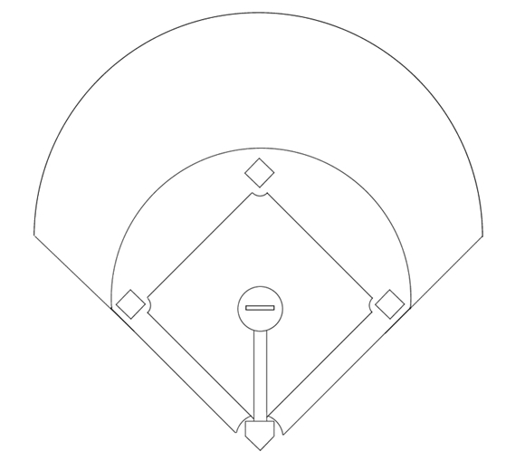
1
Pitcher
2
Catcher
8
3
1e Baser
4
2nd Baser
5
3rd Baser
7
9
6
Short Stop
7
Left Fielder
6
4
8
Center Fielder
9
Right Fielder
5
3
1
Base hit in center field.
Runner on third scores.
2

Slide 3
1
Pitcher
2
Catcher
8
3
1e Baser
4
2nd Baser
5
3rd Baser
7
9
6
Short Stop
7
Left Fielder
6
4
8
Fields the ball
9
Right Fielder
5
3
1
Batter rounds first base.
2

Slide 4
1
Pitcher
2
Catcher
8
3
1e Baser
4
2nd Baser
5
3rd Baser
7
9
6
Short Stop
7
Left Fielder
6
4
8
Fields the ball
9
Right Fielder
5
3
1
Batter rounds first base.
Runner rounds second base.
2

Slide 5
1
Pitcher
2
Catcher
8
3
1e Baser
4
2nd Baser
5
3rd Baser
7
9
6
Short Stop
7
Covers 8
6
4
8
Fields the ball
9
Covers 8
5
3
1
2

Slide 6
1
Pitcher
2
Catcher
8
3
1e Baser
4
2nd Baser
5
3rd Baser
7
9
6
Takes cutoff pos.
7
Covers 8
6
4
8
Fields the ball
9
Covers 8
5
3
1
2

Slide 7
1
Pitcher
2
Catcher
8
3
1e Baser
4
2nd Baser
5
Takes 3rd Base
7
9
6
Takes cutoff pos.
7
Covers 8
6
4
8
Fields the ball
9
Covers 8
5
3
1
2

Slide 8
1
Pitcher
2
Catcher
8
3
1e Baser
4
Takes 2nd Base
5
Takes 3rd Base
7
9
6
Takes cutoff pos.
7
Covers 8
6
4
8
Fields the ball
9
Covers 8
5
3
1
2

Slide 9
1
Covers 3rd base
2
Catcher
8
3
1e Baser
4
Takes 2nd Base
5
Takes 3rd Base
7
9
6
Takes cutoff pos.
7
Covers 8
6
4
8
Fields the ball
9
Covers 8
5
3
1
2

Slide 10
1
Covers 3rd base
2
Covers 2nd base
8
3
1e Baser
4
Takes 2nd Base
5
Takes 3rd Base
7
9
6
Takes cutoff pos.
7
Covers 8
6
4
8
Fields the ball
9
Covers 8
5
3
1
2 stays close to homeplate.
2

Slide 11
1
Covers 3rd base
2
Covers 2nd base
8
3
Takes 1st base
4
Takes 2nd Base
5
Takes 3rd Base
7
9
6
Takes cutoff pos.
7
Covers 8
6
4
8
Fields the ball
9
Covers 8
5
3
1
1 takes 2nd base if necessary.
2

Slide 12
1
Covers 3rd base
2
Covers 2nd base
8
3
Takes 1st base
4
Takes 2nd Base
5
Takes 3rd Base
7
9
6
Takes cutoff pos.
7
Covers 8
6
4
8
Fields the ball
9
Covers 8
5
3
1
Runners decide to advance
an extra base or to return.
Runners keep an eye on the
defensive play: advance on
the throw if possible
2

Slide 13
1
Covers 3rd base
2
Covers 2nd base
8
3
Takes 1st base
4
Takes 2nd Base
5
Takes 3rd Base
7
9
6
Takes cutoff pos.
7
Covers 8
6
4
8
Fields the ball
9
Covers 8
5
3
1
8 throws to 3rd base
- via the cutoff.
2

Slide 14
1
Covers 3rd base
2
Covers 2nd base
8
3
Takes 1st base
4
Takes 2nd Base
5
Takes 3rd Base
7
9
6
Takes cutoff pos.
7
Covers 8
6
4
8
Fields the ball
9
Covers 8
5
3
1
8 throws to 3rd base
...or to 4 if the runner took
a lead and is returning.
2

Slide 15
1
Covers 3rd base
2
Covers 2nd base
8
3
Takes 1st base
4
Takes 2nd Base
5
Takes 3rd Base
7
9
6
Takes cutoff pos.
7
Covers 8
6
4
8
Fields the ball
9
Covers 8
5
3
1
Never throw behind the
runner if he's not returning.
The runner can still advance
on the throw.
2

Slide 16
1
Covers 3rd base
2
Covers 2nd base
8
3
Takes 1st base
4
Takes 2nd Base
5
Takes 3rd Base
7
9
6
Takes cutoff pos.
7
Covers 8
6
4
8
Fields the ball
9
Covers 8
5
3
1
5 throws to 4, if the runner
took a large lead and is
returning to 2nd base.
9 moves to cover the throw.
2

Slide 17
1
Covers 3rd base
2
Covers 2nd base
8
3
Takes 1st base
4
Takes 2nd Base
5
Takes 3rd Base
7
9
6
Takes cutoff pos.
7
Covers 8
6
X
4
8
Fields the ball
9
Covers 8
5
3
1
If so directed:
6 cuts the ball and
checks the runner
2

Slide 18
1
Covers 3rd base
2
Covers 2nd base
8
3
Takes 1st base
4
Takes 2nd Base
5
Takes 3rd Base
7
9
6
Takes cutoff pos.
7
Covers 8
6
X
4
8
Fields the ball
9
Covers 8
5
3
1
6 throws to 2nd, 3rd,
or holds on to the ball.
2

