Slide 1
Base hit in Left Field Runner on 2nd base

Slide 2
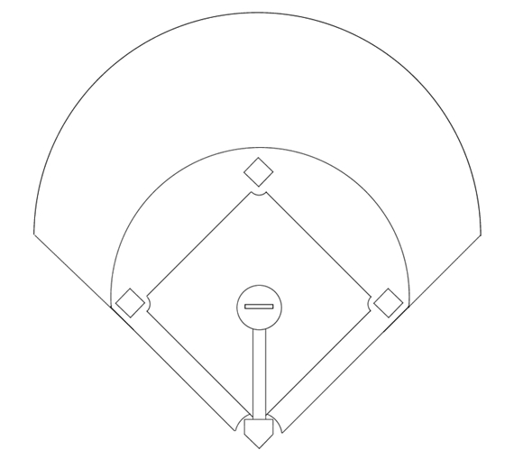
1
Pitcher
2
Catcher
8
3
1e Baser
4
2nd Baser
5
3rd Baser
7
9
6
Short Stop
7
Left Fielder
6
4
8
Center Fielder
9
Right Fielder
5
3
1
Base hit in left field. Runner on third scores.
2

Slide 3
1
Pitcher
2
Catcher
8
3
1e Baser
4
2nd Baser
5
3rd Baser
7
9
6
Short Stop
7
Fields the ball
6
4
8
Center Fielder
9
Right Fielder
5
3
1
Batter rounds first base.
2

Slide 4
1
Pitcher
2
Catcher
8
3
1e Baser
4
2nd Baser
5
3rd Baser
7
9
6
Short Stop
7
Fields the ball
6
4
8
Center Fielder
9
Right Fielder
5
3
1
Batter rounds first base. Runner rounds third base.
2

Slide 5
1
Pitcher
2
Catcher
8
3
1e Baser
4
2nd Baser
5
Takes cutoff pos.
7
9
6
Short Stop
7
Fields the ball
6
4
8
Center Fielder
9
Right Fielder
5
3
1
2

Slide 6
1
Pitcher
2
Takes homeplate
8
3
1e Baser
4
2nd Baser
5
Takes cutoff pos.
7
9
6
Short Stop
7
Fields the ball
6
4
8
Center Fielder
9
Right Fielder
5
3
1
Catcher directs third baser to the correct cutoff position.
2

Slide 7
1
Pitcher
2
Takes homeplate
8
3
1e Baser
4
Takes 2nd base
5
Takes cutoff pos.
7
9
6
Short Stop
7
Fields the ball
6
4
8
Center Fielder
9
Right Fielder
5
3
1
2

Slide 8
1
Pitcher
2
Takes homeplate
8
3
1e Baser
4
Takes 2nd base
5
Takes cutoff pos.
7
9
6
Short Stop
7
Fields the ball
6
4
8
Covers 7
9
Right Fielder
5
3
1
2

Slide 9
1
Covers homeplate
2
Takes homeplate
8
3
1e Baser
4
Takes 2nd base
5
Takes cutoff pos.
7
9
6
Short Stop
7
Fields the ball
6
4
8
Covers 7
9
Right Fielder
5
3
1
3 keeps an eye on the runner. Ready to take 1e base. Takes cutoff position if 5 doesn't make it.
2

Slide 10
1
Covers homeplate
2
Takes homeplate
8
3
Covers 2nd base
4
Takes 2nd base
5
Takes cutoff pos.
7
9
6
Short Stop
7
Fields the ball
6
4
8
Covers 7
9
Right Fielder
5
3
1
3 keeps an eye on the runner. Ready to take 1e base. Takes cutoff position if 5 doesn't make it.
2

Slide 11
1
Covers homeplate
2
Takes homeplate
8
3
Covers 2nd base
4
Takes 2nd base
5
Takes cutoff pos.
7
9
6
Short Stop
7
Fields the ball
6
4
8
Covers 7
9
Covers 2nd base
5
3
1
Covers possible throw from: 7, 5, 2
2

Slide 12
1
Covers homeplate
2
Takes homeplate
8
3
Covers 2nd base
4
Takes 2nd base
5
Takes cutoff pos.
7
9
6
...
7
Fields the ball
6
4
8
Covers 7
9
Covers 2nd base
5
3
1
Depends on the play:
6 is cutoff towards 2nd base
6 takes third base
2

Slide 13
1
Covers homeplate
2
Takes homeplate
8
3
Covers 2nd base
4
Takes 2nd base
5
Takes cutoff pos.
7
9
6
...
4
7
Fields the ball
6
8
Covers 7
9
Covers 2nd base
3
5
2
1

Slide 14
1
Covers homeplate
2
Takes homeplate
8
3
Covers 2nd base
4
Takes 2nd base
5
Takes cutoff pos.
7
9
6
...
4
7
Fields the ball
6
8
Covers 7
9
Covers 2nd base
3
5
Runners decide to advance an extra base or to return. Runners keep an eye on the defensive play: advance on the throw if possible
2
1

Slide 15
1
Covers homeplate
2
Takes homeplate
8
3
Covers 2nd base
4
Takes 2nd base
5
Takes cutoff pos.
7
9
6
...
4
7
Fields the ball
6
8
Covers 7
9
Covers 2nd base
3
5
7 throws home
2
1

Slide 16
1
Covers homeplate
2
Takes homeplate
8
3
Covers 2nd base
4
Takes 2nd base
5
Takes cutoff pos.
7
9
6
...
4
7
Fields the ball
6
8
Covers 7
9
Covers 2nd base
3
5
7 throws home ...or to 4 if no action is possible at home.
2
1

Slide 17
1
Covers homeplate
2
Takes homeplate
8
3
Covers 2nd base
4
Takes 2nd base
5
Takes cutoff pos.
7
9
6
...
4
7
Fields the ball
8
Covers 7
9
Covers 2nd base
X
3
5
6
If so directed: 5 cuts the ball and checks the runner
2
1

Slide 18
1
Covers homeplate
2
Takes homeplate
8
3
Covers 2nd base
4
Takes 2nd base
5
Takes cutoff pos.
7
9
6
...
4
7
Fields the ball
8
Covers 7
9
Covers 2nd base
X
3
5
6
If so directed: 5 cuts the ball and checks the runners/ throws whereto directed
2
1

